Slide 1
MAR 530: Ecosystem Based Fisheries Management
Lecture 2
Challenges facing fisheries, Origins & history of EBFM
www.mycourses.umassd.edu
06 February 2015

Slide 2
Review
Introductory materials
What is EBFM?

Slide 3
Today’s Outline
Fisheries Science review, history of EBFM
Challenges facing fisheries
What does EBFM have to offer?
Discussion on:
Caddy 1999
Guerry 2005
Browman & Stergiou 2004

Slide 4
One Main Theme Throughout Course
CONFRONTING TRADEOFFS

Slide 5
Simplified Schedule
Week | Theme | Topic
1/30 | Context | Introduction, What is EBFM?
2/6 |  | Challenges facing fisheries, what can EBFM offer?
2/13 |  | Guest lecture: case studies of EBFM
2/20 |  | Types of advice, decision theories, goal-setting
2/27 | Operational | Bycatch, habitat, and spatial management
3/6 |  | Ecosystem indicators
3/13 |  | Extended single-species and multispecies models
3/20 |  | SPRING BREAK
3/27 |  | Aggregate and system models
4/3 |  | Ecological risk assessment
4/10 | Institutional | Societal and economic considerations
4/17 |  | Governance and management institutions
4/24 | Holistic | Evaluating tradeoffs
5/1 |  | Moving towards ecosystem based management
5/13 |  | Final exam: Project Presentations

Slide 6
“The trail of fisheries science is strewn with the opinions of those who, while partly right, were wholly wrong.”
Michael Graham, “The Fish Gate”, 1943

Slide 7
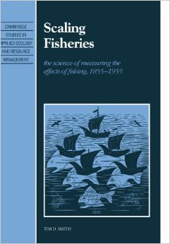
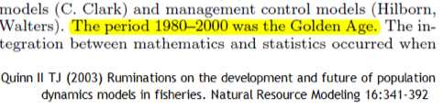
Major eras in Fisheries Science
Pre-Renaissance
1850-1899 era
1900-1920
1921-1940
1941-1960
1961-1980
1981-present

Slide 8
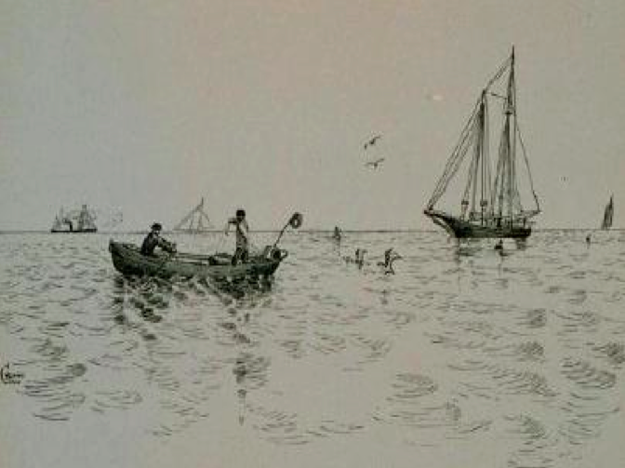
1850-1899
Emphasis on Natural History
Inclusive, holistic, observational approach
First Marine/Fisheries labs formed
Government subsidized research
Mediate differences among states and nations
Recognized declines in marine populations
Moving beyond an accumulation of species lists
Paradigm shift that marine resources might not be inexhaustible

Slide 9
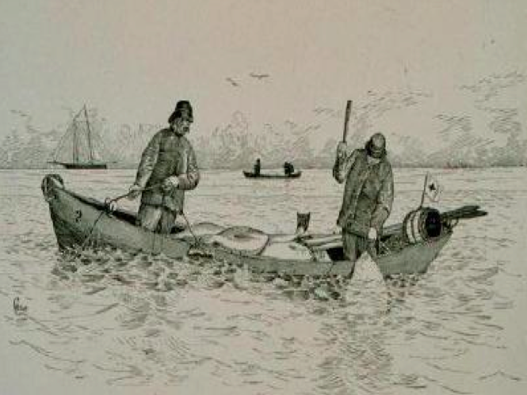
1900-1920
Formalization of many biological fields as scientific discipline
Notable changes in fish stocks during and after WWI
Political, economic, and similar pressures associated with fisheries science heightened
Still simple fishing methods
International disputes and scientific debates intensified (and continues to this day)

Slide 10
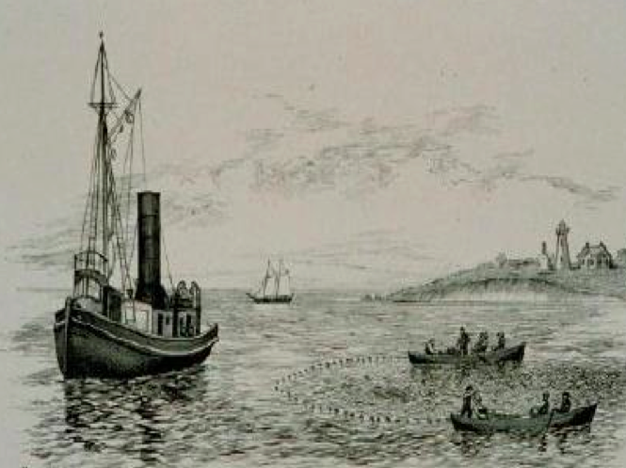
1921-1940
Formulation of Biological Processes
Lotka-Volterra Models, Elton’s Pyramid, Gausian Models, Hjort’s Model, Pearl’s Model, Clements, Shelford, etc.
Disciplinary Specialization
Ecology, Oceanography, Fisheries Biology
Fishing technology rapidly expands
Advent of on-site freezing
Majority of fishing fleet converted from sail to engine powered vessels, from longlining/handlining to bottom trawls

Slide 11
1941-1960
Single Species emphasis in Fisheries
Graham, Ricker, Beverton & Holt, Schaefer, Leslie
Community Emphasis in Ecology
Density dependent vs. independent factors
Andrewartha & Birch, Lindeman, Holling, Hutchinson
Rapid developments in Oceanography
Quantification of physical and chemical processes
Marine Biology still a naturalist focus
Notable changes in fish stocks during and after WWII
ICNAF/ICES/IWC/FAO/etc. advice formalized

Slide 12
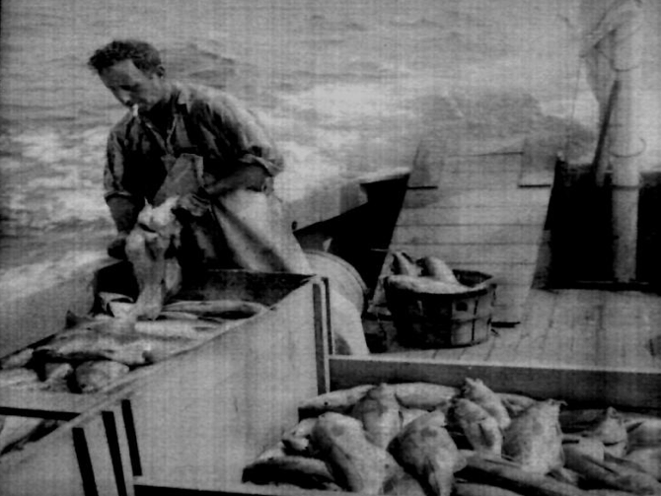
1961-1980
Multispecies emphasis in fisheries models MSVPA, MSYPR, Aggregate Production, etc.
Research emphasis
Advice still single species
Ecology leaves the ivory tower
Pollution, World population concerns
Development of Systems Ecology
Physical-biological emphasis in Oceanography
Magnuson Act, ESA, MMPA, Law of the Sea
Conservation awareness reemphasized
EEZ, Nationalization of fisheries

Slide 13
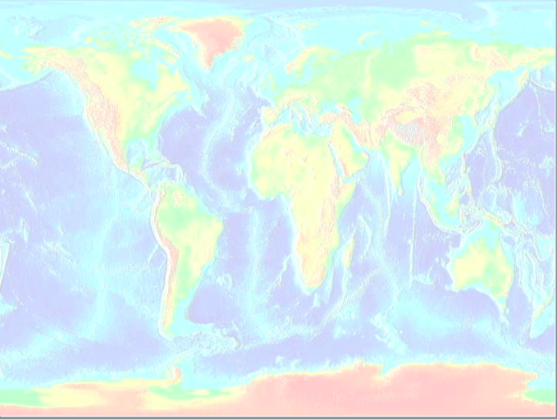
1981-present
Synthesis of Ecological Theories
Food web theory, trophic cascades, landscapes,etc.
Oceanography attempts global integration
Remote sensing, automated data collection, etc.
Extension of Fisheries models
More multispecies models, habitat concerns, system models, etc.
Reconvergence of different disciplines
Climate Change Concerns
Controversies:
Continued overfishing
Most world’s stocks at or near over-fished levels
Sequential depletion of fish stocks

Slide 14
Origins and history of EBFM
Thomas Huxley (1883)
“all the great sea-fisheries are inexhaustible; that is to say nothing we can do seriously affects the number of fish.”

Slide 15
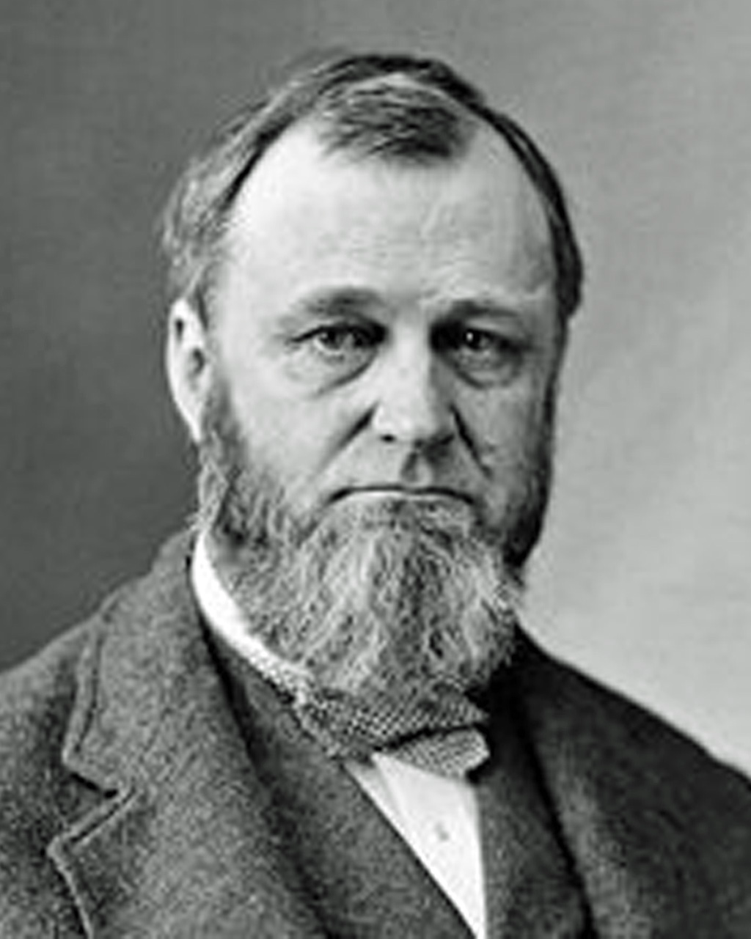
Spencer Baird:

Slide 16
Spencer Baird (1872)- Describing the possible causes of the decrease in MA and RI fisheries:
The decrease or disappearance of the food upon which the fish subsist, necessitating their departure to other localities.
A change of location, either entirely capricious or induced by the necessity of looking for food elsewhere, as just referred to.
Epidemic diseases, or peculiar atmospheric agencies, such as heat, cold, etc.
Destruction by other fishes.
The agency of man; this being manifested either in the pollution of the water by the discharge into it of the refuse of manufactories, etc. or by excessive overfishing, or the use of improper apparatus.

Slide 17
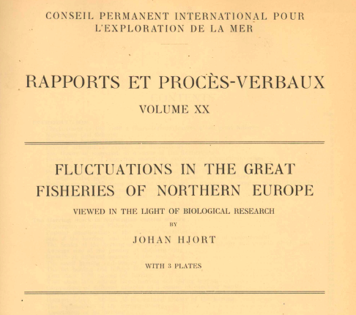
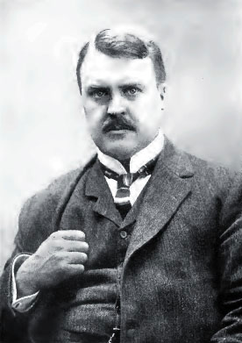
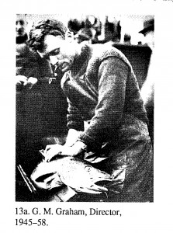
Origins and history of EBFM
Baird 1873
Lankester 1884
Hjort 1910s-20s
Lotka 1925
Volterra 1926
Graham 1943
‘Thompson-Burkenroad’ debate (Skud 1975)
Hjort 1914

Slide 18
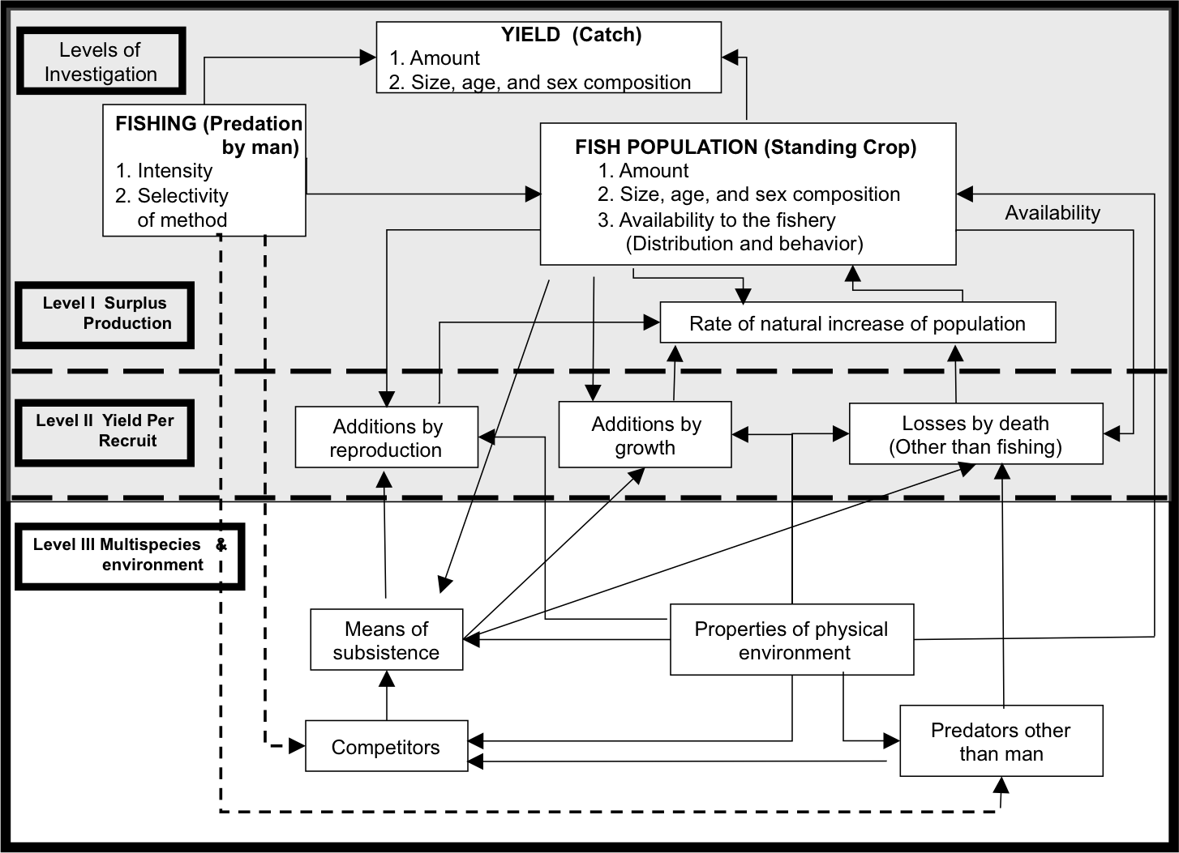
Schaefer’s Three Tiers (1950s)
Notes:
Thompson vs. Burkenroad debate 1940s
IPHC; fishing vs. environment
Sette, Herrington, etc. with Thompson

Slide 19
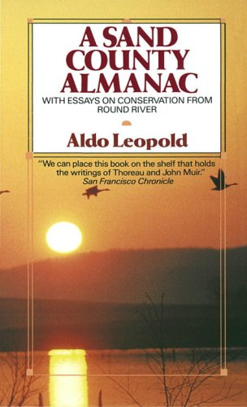

Key literary foundations to EBM
Leopold 1949 “Sand County Almanac”
Carson 1962 “Silent Spring”
Holling 1978 “Resilience and Stability of Ecological Systems”
Walters 1986 “Adaptive Management”

Slide 20
Where did EBM and related approaches more recently and formally come from?
International recognition in the 1970s, 1980s, to early 1990s that the earth’s ecosystems were being/had been seriously impacted by human use.
to the point that future human development, economic benefits and well-being would be threatened.
Creation of the sustainable development agenda, related international agreements, and in some cases national enabling arrangements
For individual uses / industry sectors as well as the cumulative impact of all uses in regional ecosystems.
Sainsbury 2004

Slide 21
Origins and history of EBM
Stockholm Conference on Human Development (1972)
Convention on International Trade in Endangered Species (1973)
Bonn Convention on Migratory Species of Wild Animals (1979)
UN Convention on the Law of the Sea (1982)
World Commission on Environment and Development (1987)

Slide 22
Origins and history of EBM/EBFM
UN Convention on Environment and Development (1992)
clearly established the Sustainable Development agenda.
Convention on Biological Diversity (1992)
Jakarta Mandate (1995)
FAO Code of Conduct for Responsible Fisheries (1995)
Reykjavik Conference (2001)
World Summit on Sustainable Development (2002)

Slide 23
The (Ecologically) Sustainable Development agenda effectively has not changed
"Sustainable development is … a process of change in which the exploitation of resources, the direction of investments, the orientation of technological development, and institutional change are made consistent with future as well as the present needs.“ (Brundtland Report 1986)
“sustainable development meets the needs of the present without compromising the ability of future generations to meet their own needs” (FAO 2003)
Maintain options and reversibility on human generation time scale
Intergenerational equity
Long term not just short term
Sainsbury 2004

Slide 24
Challenges Facing Fisheries

Slide 25
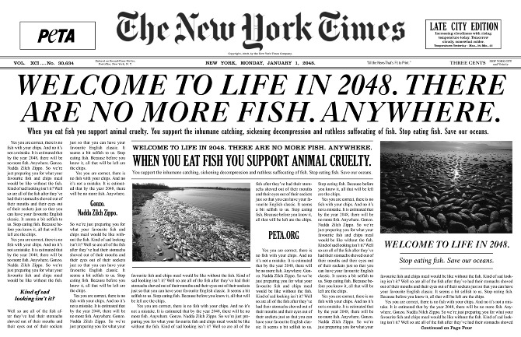
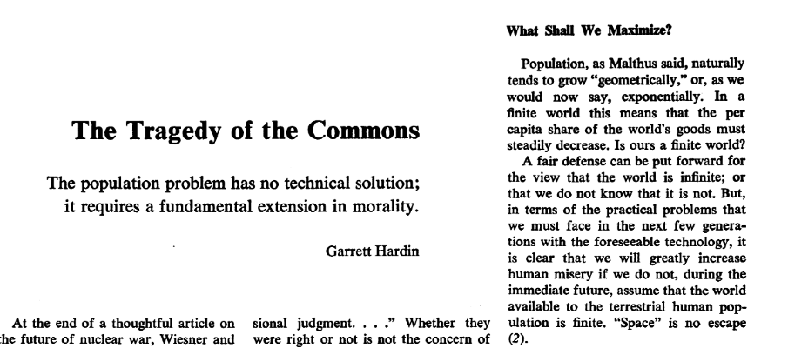
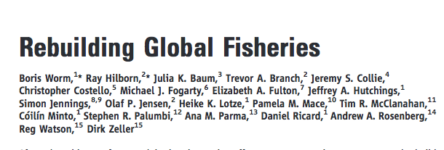
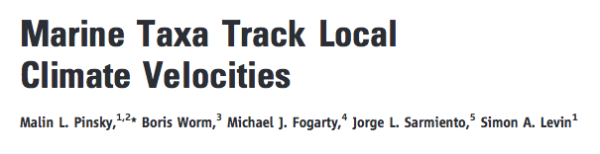
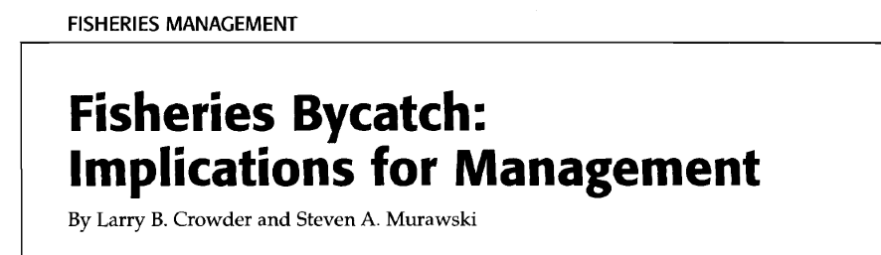
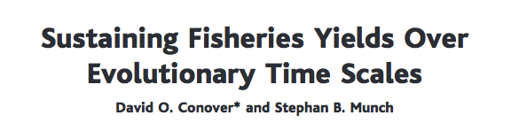
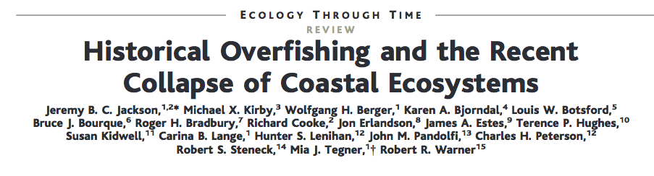
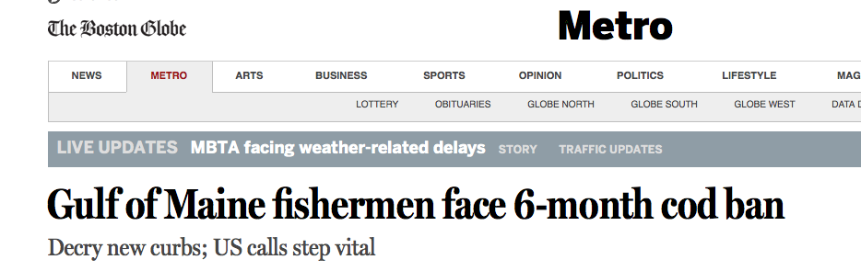
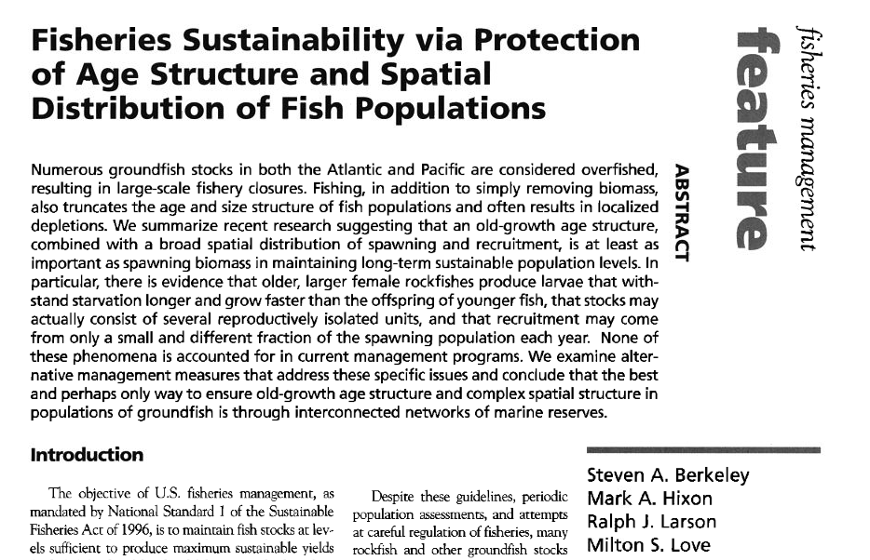

Slide 26
Litany of Issues
Tragedy of the commons: the race for fish
Overcapitalization of world’s fisheries
Fishing down the food web
Only so much primary productivity to produce fish.
Bycatch of non-target species
Decline in large predators
Loss of marine biodiversity, No fish by 2048
Over 70% of the world’s fish stocks are fully or over- utilized (FAO, Garcia et al., Pikitch et al.)
Sequential depletion

Slide 27
Litany of Issues continued….
Climate effects on distribution, productivity
Increasing focus on invertebrates and forage fish fisheries
Coastal zone erosion- eutrophication, fishing, etc. led to loss of large animals, living habitats
Rebuilding/recruitment failures
Stock collapses, collapses of associated fisheries
IUU (Illegal, Unreported, Unregulated) Fishing
Effects of mobile fishing gear on benthic habitats

Slide 28
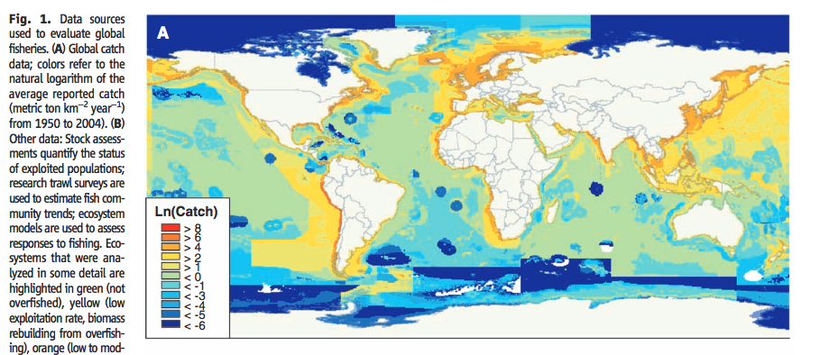
Global fishery catch data

Slide 29
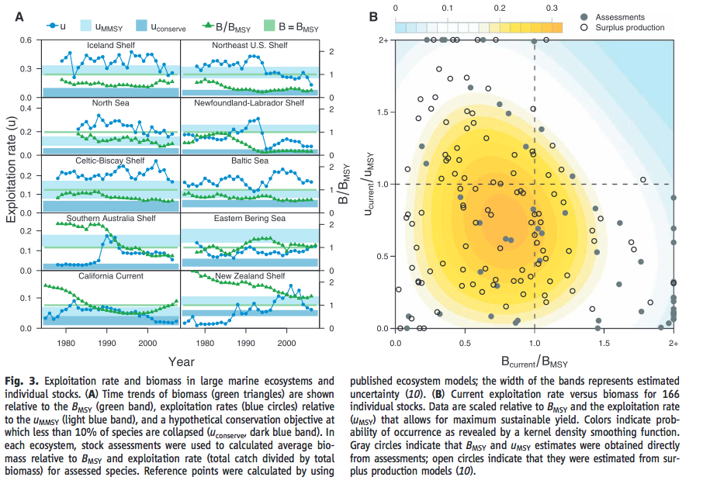
Stock status of world’s fisheries
gere
Worm et al. 2009

Slide 30
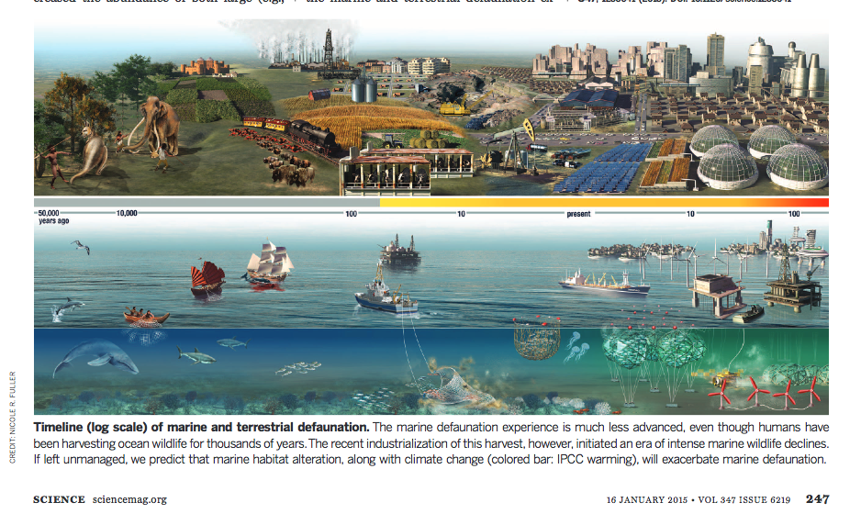
Increase in type and intensity of human uses in the marine environment
McCauley et al 2015

Slide 31
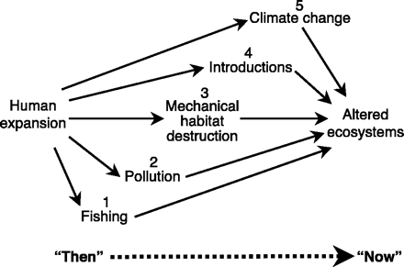
Overfishing and “Collapse” of Coastal Ecosystems
Jackson et al. 2001

Slide 32
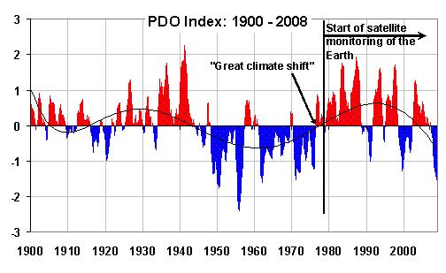
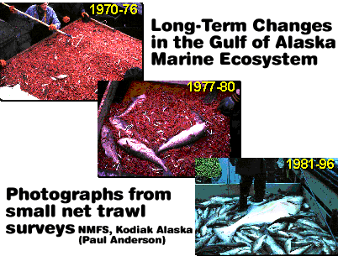
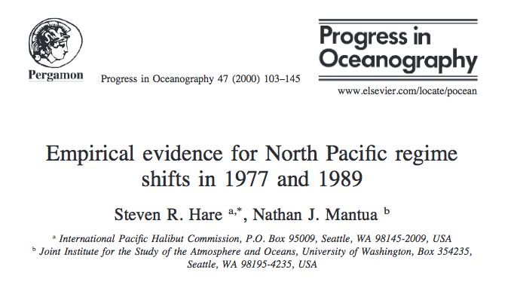
Large-scale changes in ecosystem productivity

Slide 33
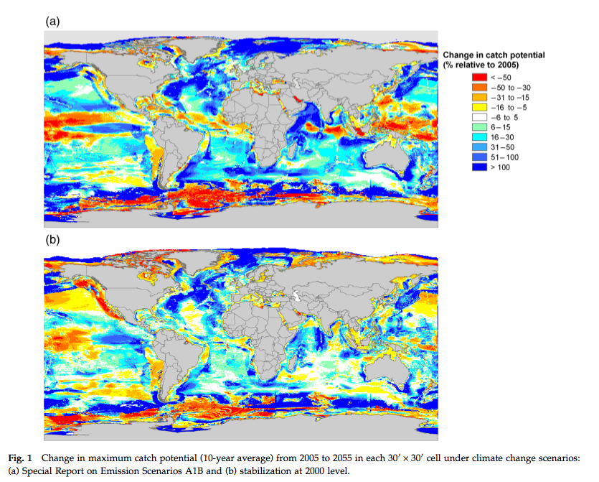
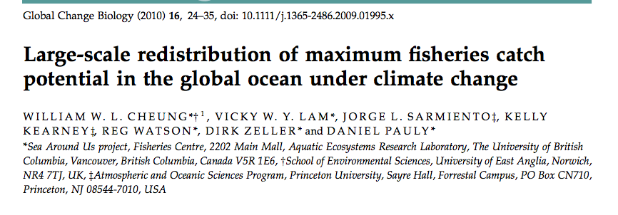
Climate change: concerns about the effects of warming, ocean acidification, etc.

Slide 34
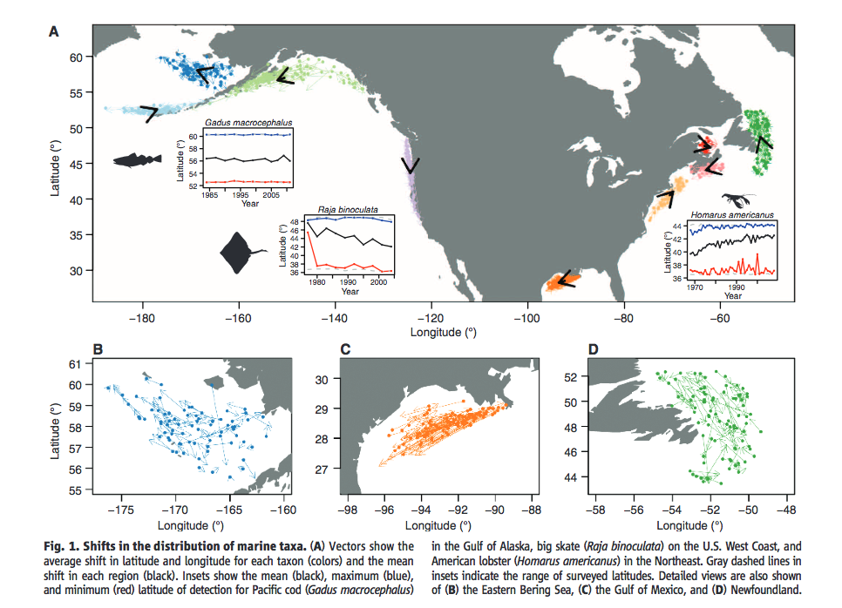
Shifts in distribution of marine species
Pinsky et al. 2013

Slide 35
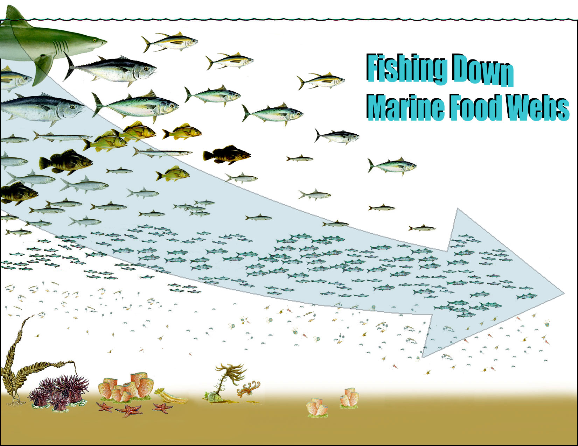
Daniel Pauly

Slide 36
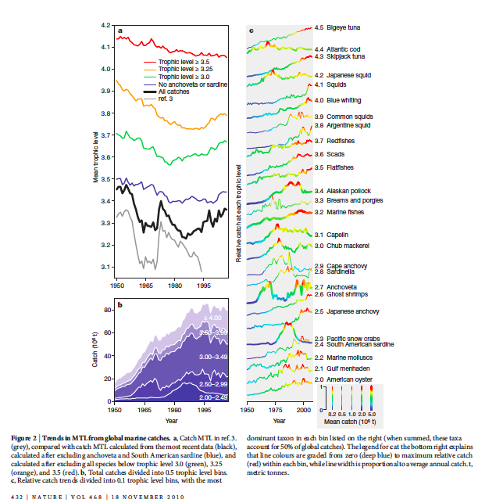
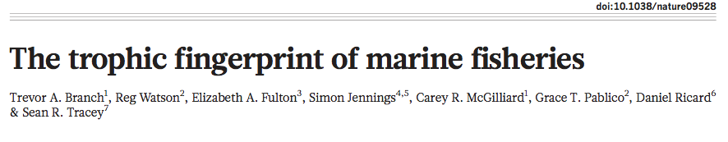

Slide 37
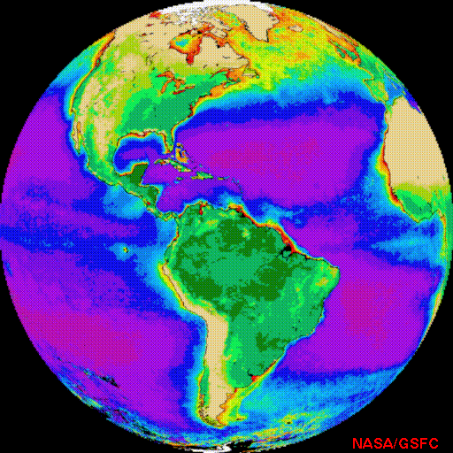
Primary Production Required to
Sustain Global Fisheries
Open Ocean:
2%
Non-tropical
Shelves: 35%
Tropical
Shelves: 35%
Coastal/Reefs:
8%
Upwelling:
25%
Pauly and Christensen (1995) Nature 374

Slide 38
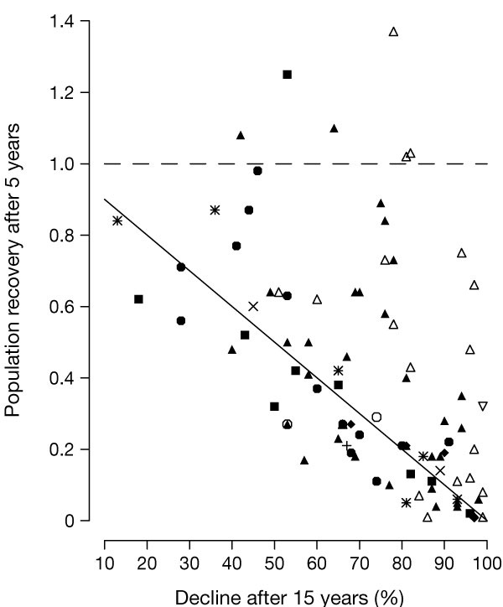
Lack of Recovery/Recruitment
Hutchings 2000
Notes:
The ordinate refers to the size of a population 5 years after the proportionately largest 15-year decline experienced by that population, relative to its size at the beginning of its 15-year decline. Populations that experienced some recovery are represented by points to the right of the solid line. Fully recovered stocks are represented by points on and above the dashed line. One datum—a 69% population decline of one clupeid followed by a 1.78 recovery—has been omitted for clarity. Slanted crosses, Engraulidae; upward triangles, Clupeidae; downward triangles, Osmeridae; filled triangles, Gadidae; stars, Scorpaenidae; upright crosses, Anoplopomatidae; filled diamonds, Sparidae; diamonds, Nototheniidae; filled squares, Scombridae; filled circles, Pleuronectidae; circles, Soleidae.

Slide 39
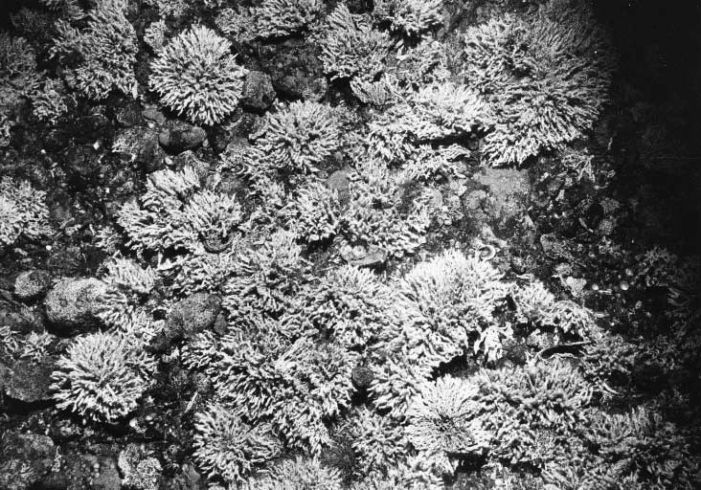

Benthic Habitat Effects
Collie et al. 2000

Slide 40
What does EBFM have to offer?
Why commit to something that is not “typical” or normative in this profession, costs more money/data, and adds uncertainty?

Slide 41
Some reasons “Ecosystem Management” is currently an issue
Competing stake-holders and legislation
Debate over the importance of different processes (fishing, environment, predation, etc.)
Limitations of single species management
Used as a scapegoat for lack of action
Adversarial science- scientists as advocates
Do you think EM/EBFM will help address some of the issues just noted?
Or help us to think about them in different ways?

Slide 42
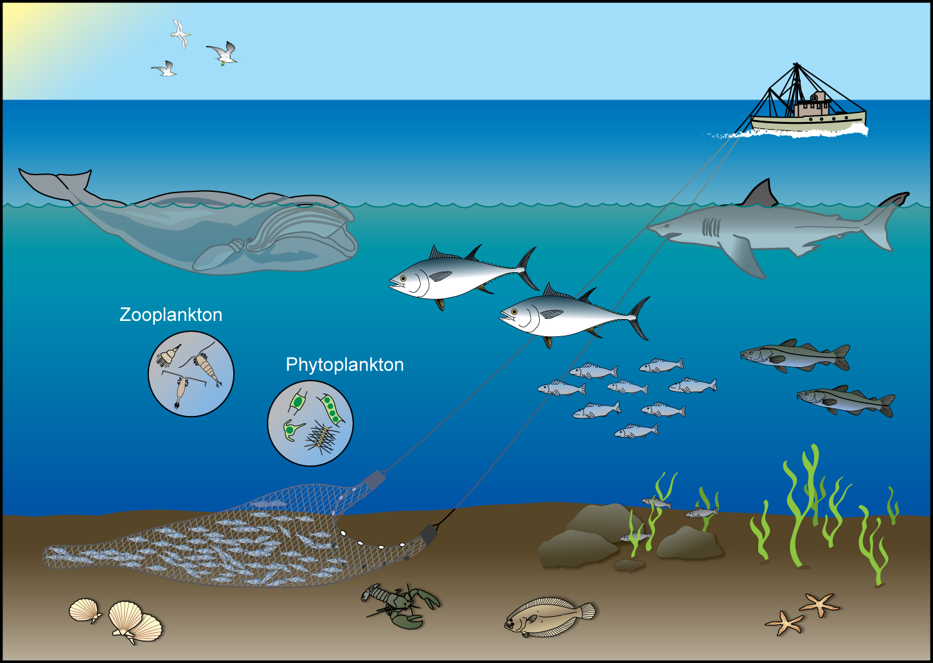
The ecosystem defined
An ecosystem is a geographically specified system of organisms (including humans), the environment and the processes that control its dynamics (NOAA 2004).

Slide 43
Ecosystem-Based Management
“U.S. ocean and coastal resources should be managed to reflect the relationships among all ecosystem components, including human and nonhuman species and the environments in which they live. Applying this principle will require defining relevant geographic management areas based on ecosystem, rather than political, boundaries.”
U.S. Commission on Ocean Policy

Slide 44
What is the issue?
Is fishing impacting other ecosystem components and properties?
Impacts to other fishing sectors
Impacts across broader ocean-use sectors
Impacts to other, legally considered spp.
Are other ecosystem considerations impacting the fishery?

Slide 45
Single species approaches don’t usually (explicitly) consider:
Species interactions
Changes in ecosystem structure & function
Biodiversity
Non-fishing ecosystem services & values
Needs of protected or rare species
Ecosystem effects of discarding unwanted bycatch
Fishing gear impacts on habitat

Slide 46
Ecosystem approaches/models don’t usually (explicitly) consider:
Age/size-based variation in demographic parameters
Density-dependent effects
Stock-recruitment relationships
Effects of fishing on genetic diversity
Economic tradeoffs
Standards, reference points and performance statistics

Slide 47
What does an ecosystem approach provide that we can’t get from single-species?
Addresses effects of fishing on non-target species, habitat, ecological interactions, and system-wide processes
Recognizes that marine ecosystems provide “goods & services” other than fishery harvest
Explicitly addresses biomass tradeoffs
Increases leverage from new stakeholders
Changes the burden of proof

Slide 48
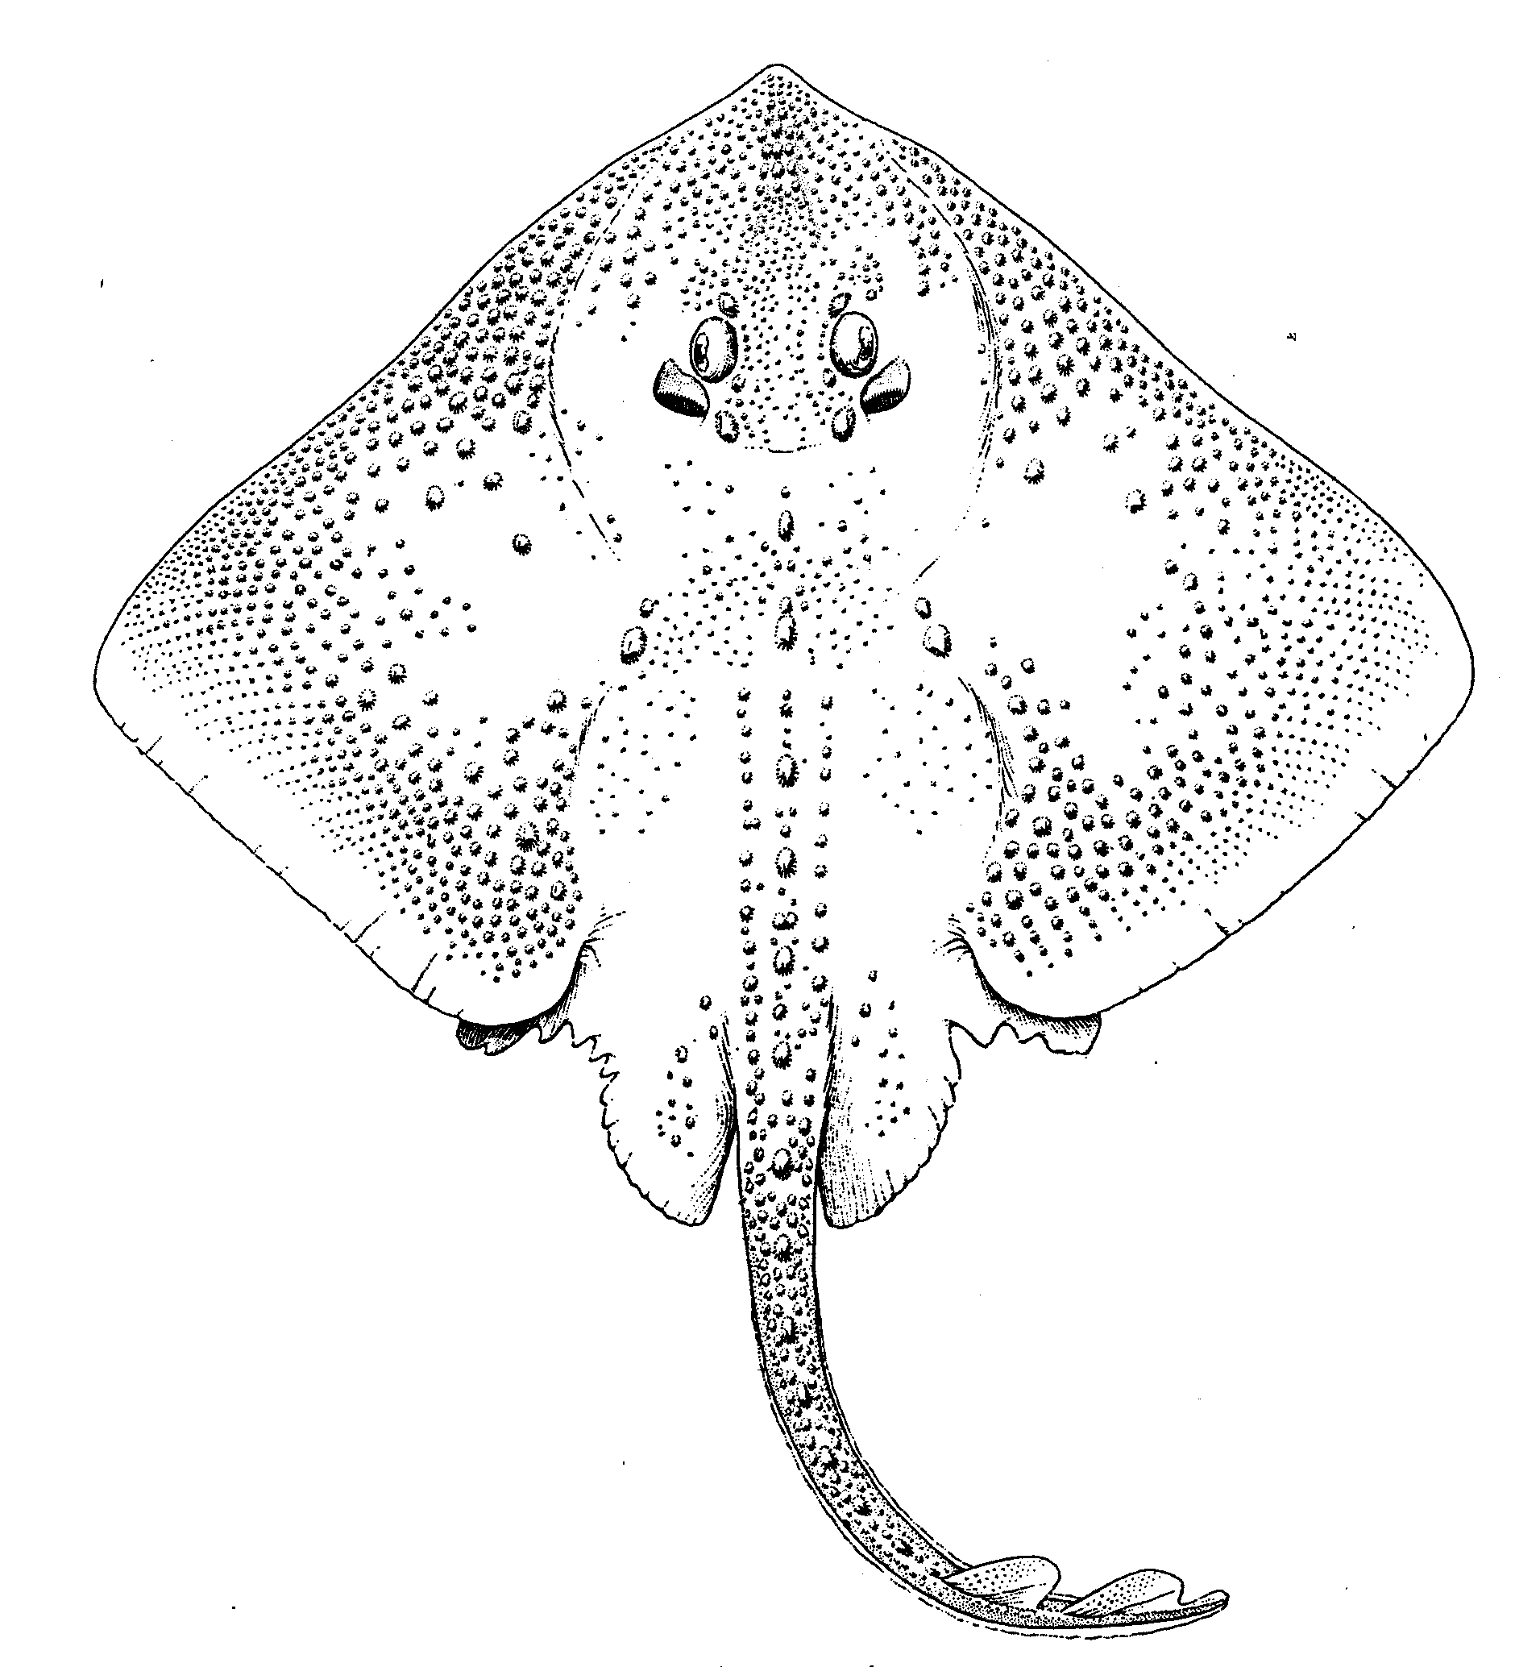
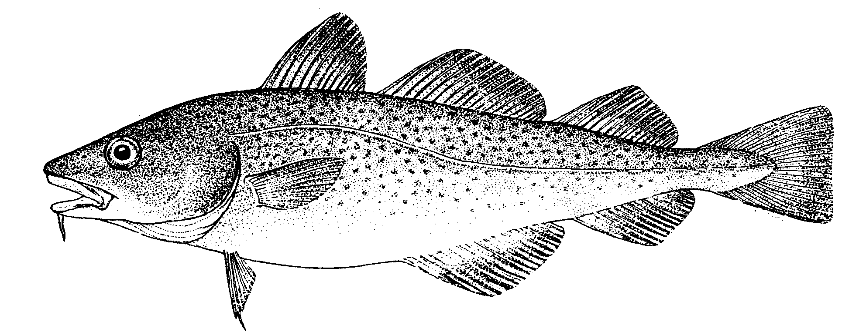
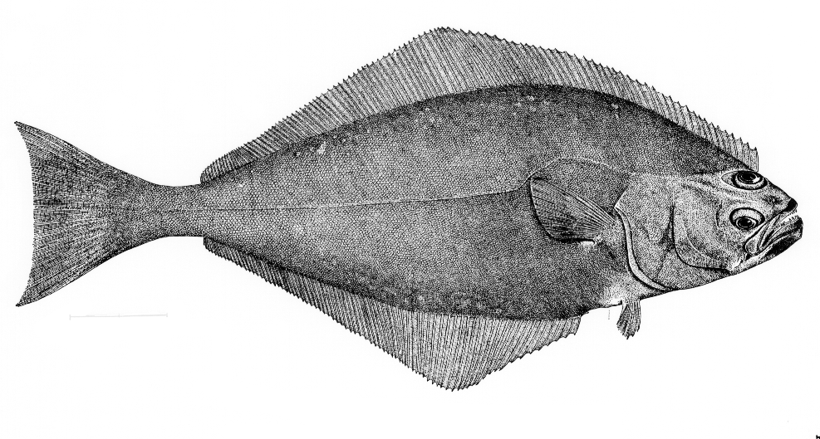
Can Control & Measure Fishing Effort
Realism
Parsimony
Addresses Ecosystem Issues
Existing Methods and Metrics
Data Requirements (=Cost)
Stock/Single Species
Multi-species
Aggregate Biomass
Ecosystem
Messy Picture Here
Gadids
Pelagics
Flatfish
Predation, Competition, Mutualism, etc.
Habitat, Climate, etc.
Disease, Genetic Diversity, Fecundity, Migration, etc.
Technical Interactions

Slide 49
Doing EBFM
Questions?

Slide 50
What’s Next
Guest lecture: Jason Link, NOAA Fisheries
Case studies of EBFM
When should we consider doing EBFM?
Discussion on:
Christensen et al. 1996
Yaffee 1999
Arkema et al. 2006
Marasco et al. 2007

Slide 51
Example Efforts at Defining EBM
Marine
Larkin 1996
Botsford et al. 1997
EPAP 1999
Link 2002
Pikitch 2004
USCOP 2004
POC 2004
Browman & Stergiou 2004
General/Terrestrial
Slocombe 1993
Grumbine 1994, 1997
Haueber 1996
Christensen et al. 1996
Yaffee et al. 1996
Franklin 1997
Boyce & Haney 1997
Lackey 1998

Slide 52
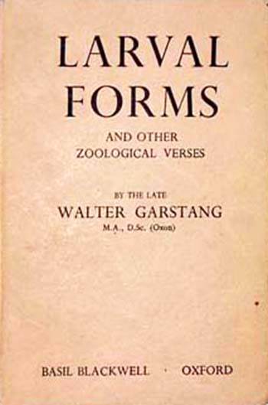
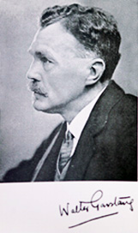
Walter Garstang (1868-1949)

